Slide 1
Acute leukaemia and post-traumatic development
There would be no joy if the Cross did not exist in our lives.
Patient experience
Juraj Sedlacek, Slovakia

Slide 2
Acute leukaemia and post-traumatic development
Transplant Sterile Unit
Pain, Being Alone and Loneliness, Members of a Health Care Team you Have Good Relations with
Point of View of a Health Care Team Member
Post-traumatic Development, www.ebmt.sk

Slide 3
Transplant Sterile Unit
Slovakia in 2003
Preparation: Mileran, Busulfan, Cyclophosphamide
Transplantation of peripheral stem cells from my sibling
42 days
Impossible to describe all the emotions
Uncertain prognoses, Hope
The patients´ days are made by nurses and doctors
Professionalism, Authenticity
The values and virtues starts to be changed
Question: „Why? “

Slide 4
Pain, Being Alone and Loneliness
Members of a Health Care Team you Have Good Relations with
Pains create feelings of isolation
Questions about the sense of their lives
Member of the health care team - usual working day
Empty atmosphere, loss of trust
Answers to all questions
Individual way of coping with the difficulties
Good chance to re-evaluate my own life
One year or two of “silence”

Slide 5
Point of View of a Health Care Team Member
After 12 year interval, as a member of a health care team:
Sympathy shown to patients
Burnt-out syndrome
Not everybody is thankful
Helples, faced the death, patient´s pain, failed to help
Manifestation of compassion is a demanding and tiring process
Team of nurses try to protect themselves
Patients are unaware of the existence of such issues.

Slide 6
Post-traumatic Development
Each transplantation might not be successful
What does success mean?
Attitude towards their lives have been changed and although the treatment failed
Transformation
Understanding life
New sense

Slide 7
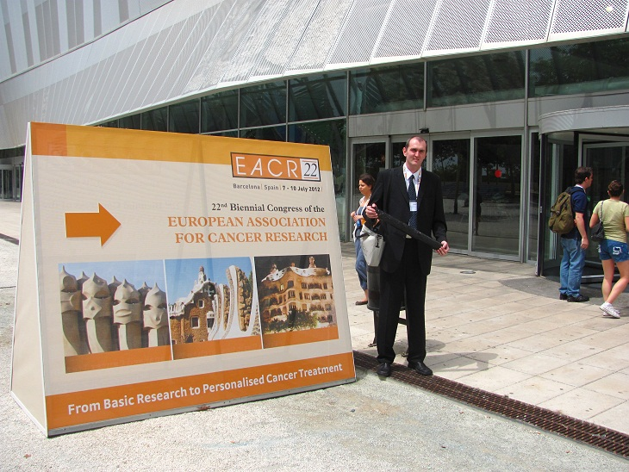
Personal details that I have experienced
Published dissertation: “Fathers´ pains”
Crisis in Slovak families and especially the crisis of fatherhood
European Association for Cancer Research, Barcelona in 2012
Japanese Society of Medical Oncology, Sendai 2013
Teaching at two universities, University pastoral centres

Slide 8
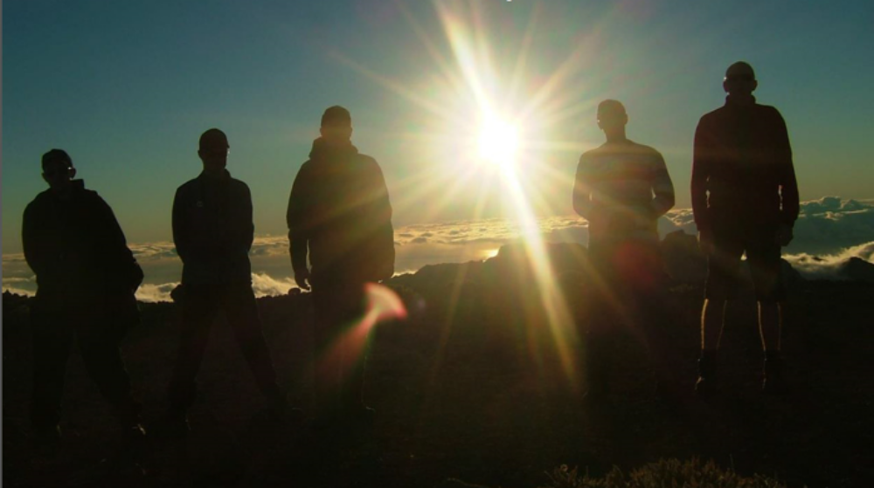
Personal details that I have experienced
Highest peak of the Atlantic,
Pico-del-Teide 3718m
If someone had told me…
I would have laughed him/her

Slide 9
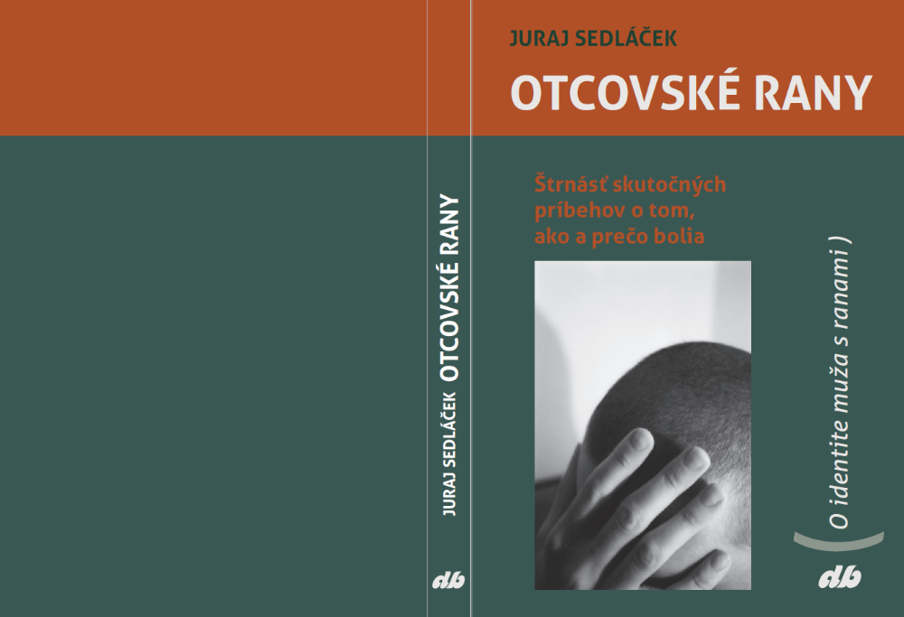
Fathers´ pains
14 challenging and traumatic cases

Slide 10
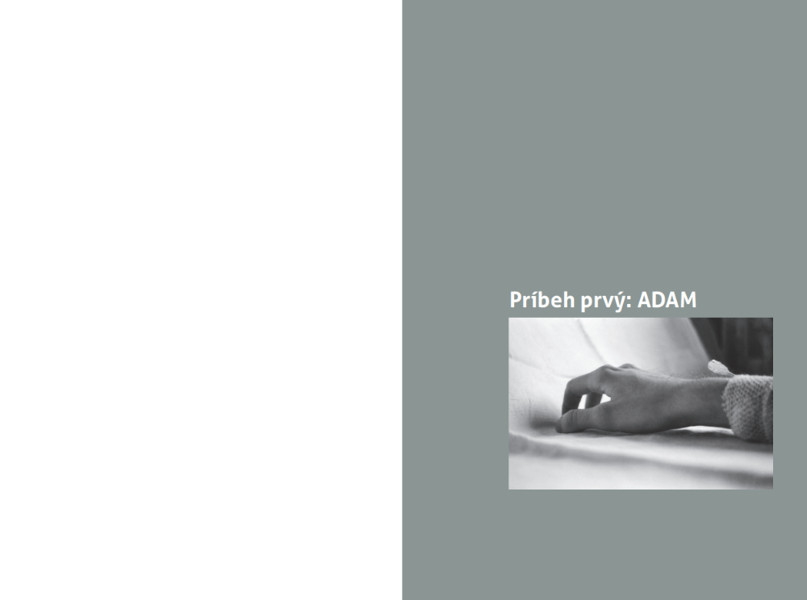
Fathers´ pains
14 challenging and traumatic cases

Slide 11
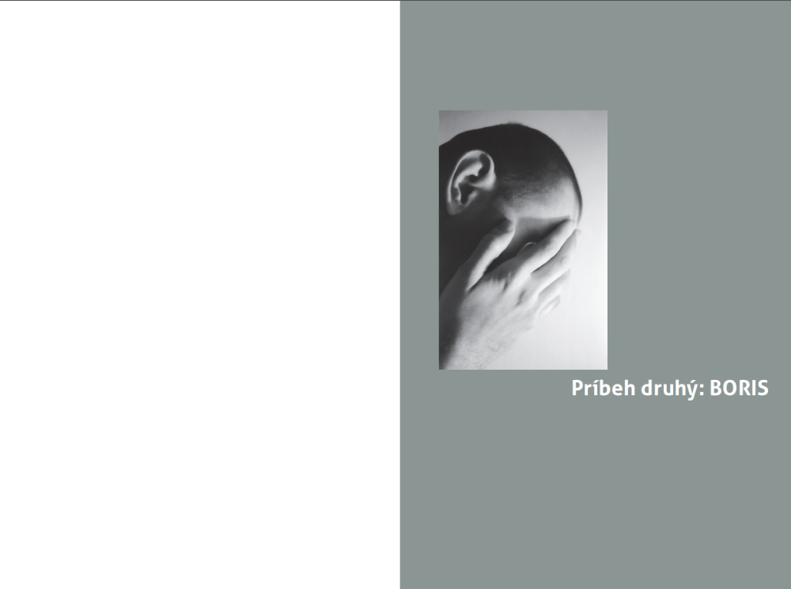
Fathers´ pains
14 challenging and traumatic cases

Slide 12
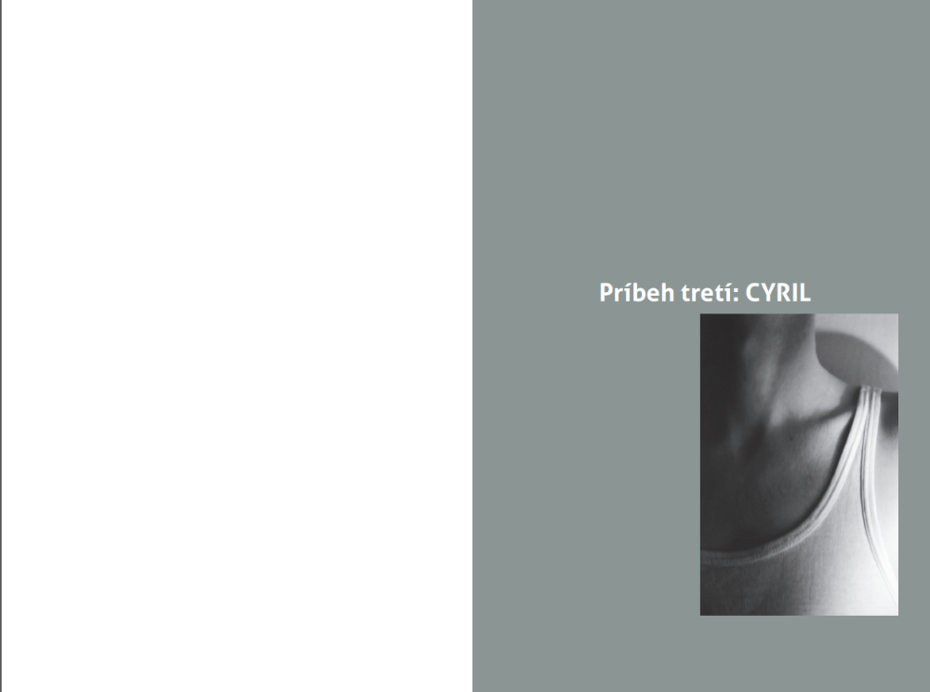
Fathers´ pains
14 challenging and traumatic cases

Slide 13
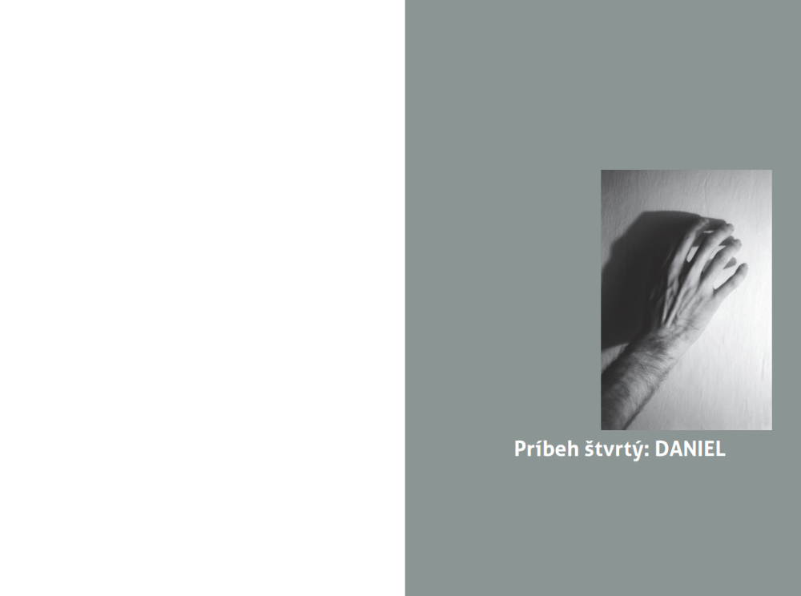
Fathers´ pains
14 challenging and traumatic cases

Slide 14
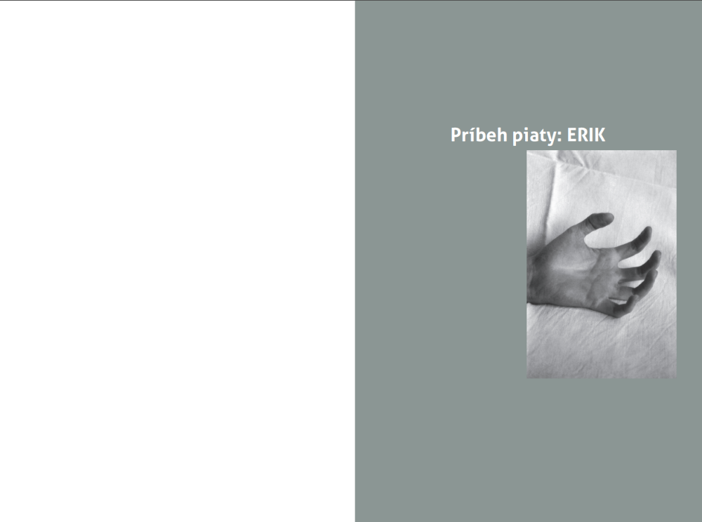
Fathers´ pains
14 challenging and traumatic cases

Slide 15
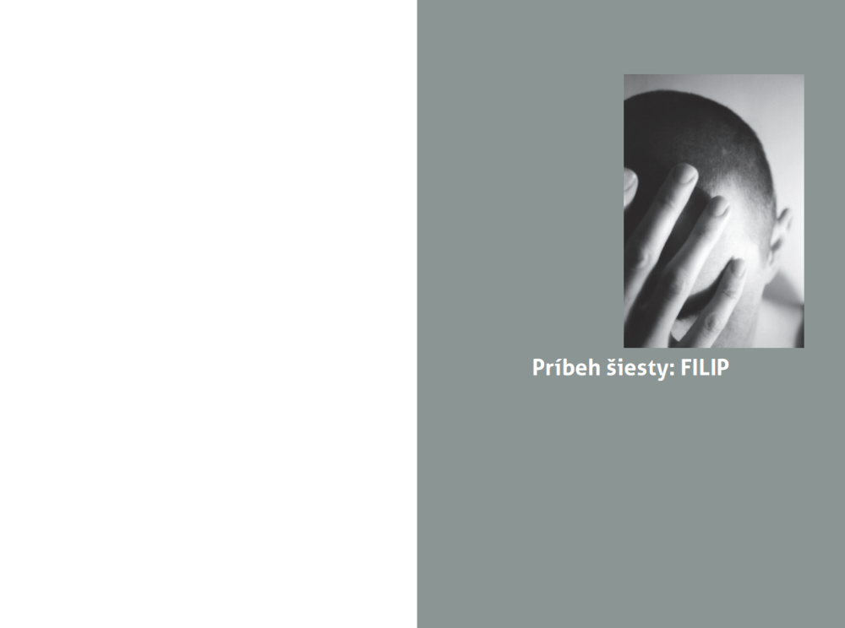
Fathers´ pains
14 challenging and traumatic cases

Slide 16
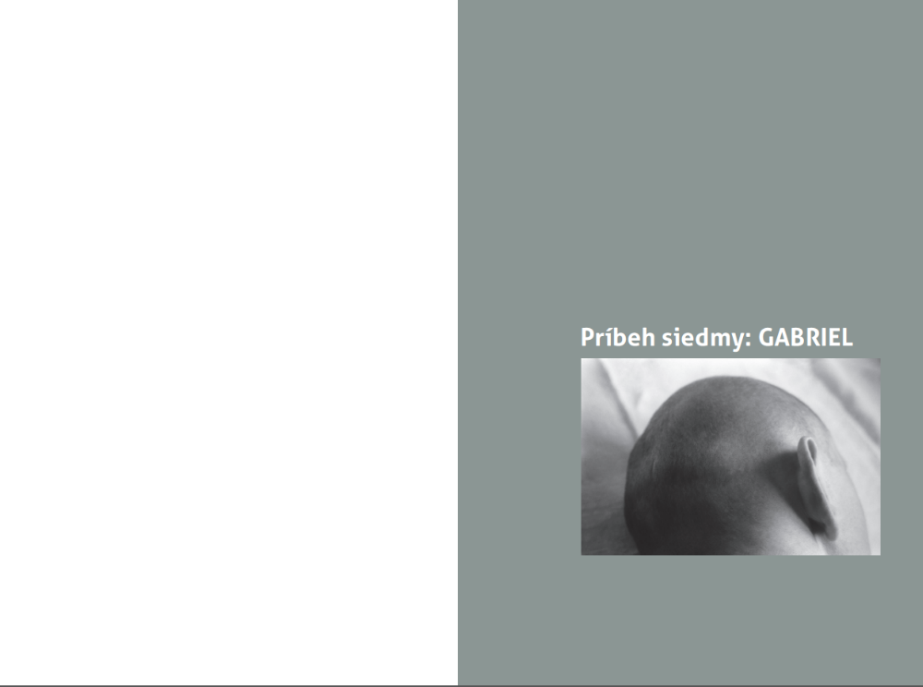
Fathers´ pains
14 challenging and traumatic cases

Slide 17
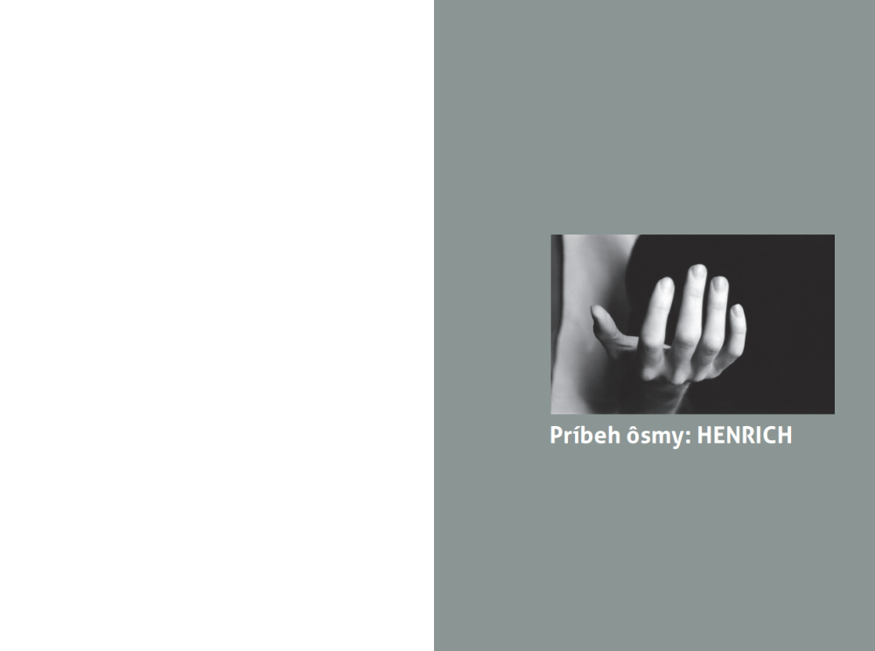
Fathers´ pains
14 challenging and traumatic cases

Slide 18
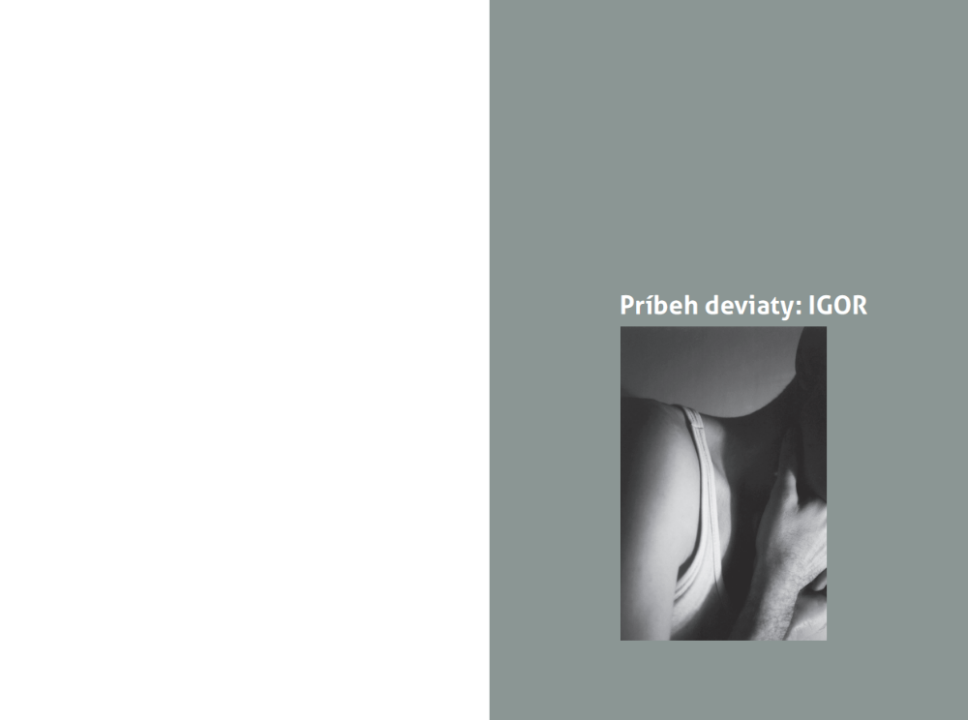
Fathers´ pains
14 challenging and traumatic cases

Slide 19
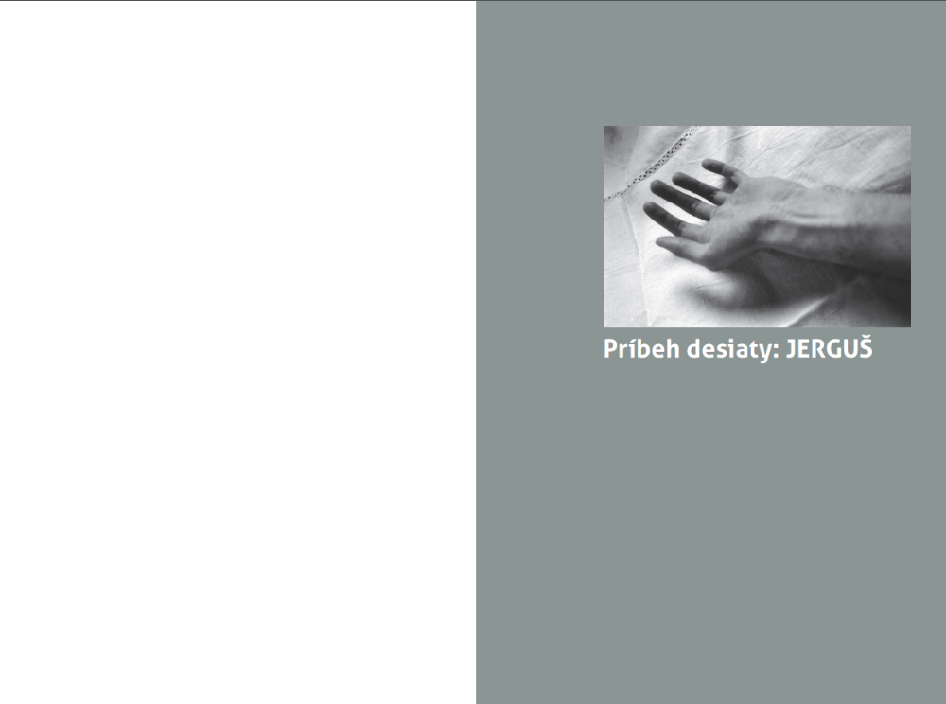
Fathers´ pains
14 challenging and traumatic cases

Slide 20
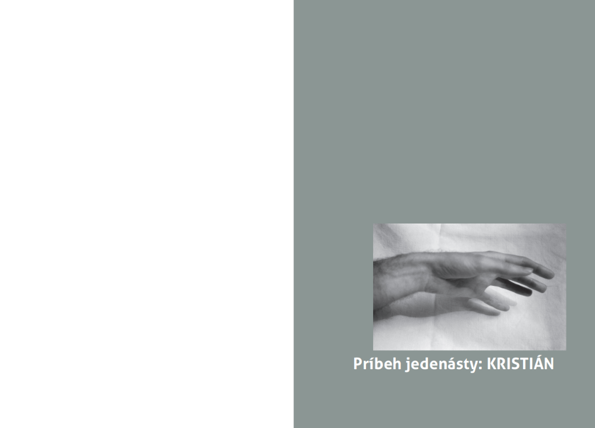
Fathers´ pains
14 challenging and traumatic cases

Slide 21
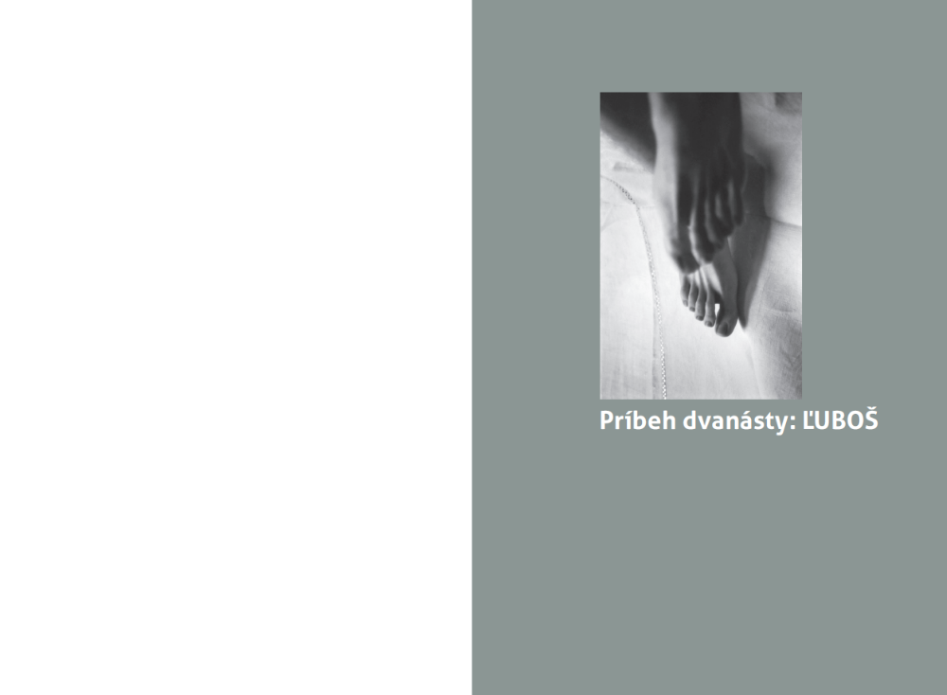
Fathers´ pains
14 challenging and traumatic cases

Slide 22
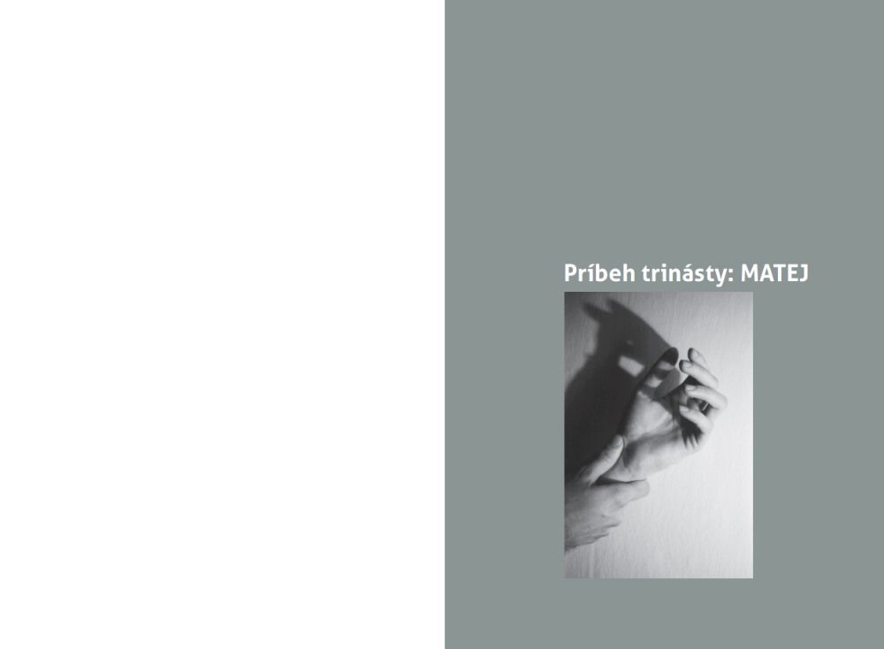
Fathers´ pains
14 challenging and traumatic cases

Slide 23
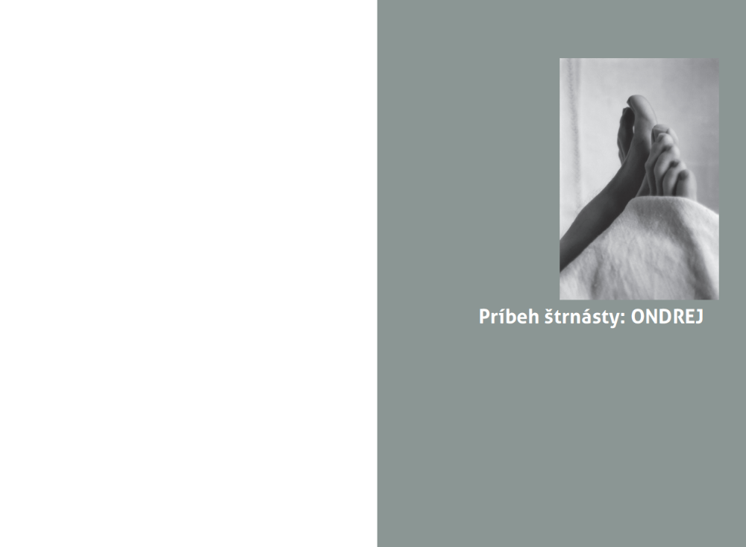
Fathers´ pains
14 challenging and traumatic cases

Slide 24

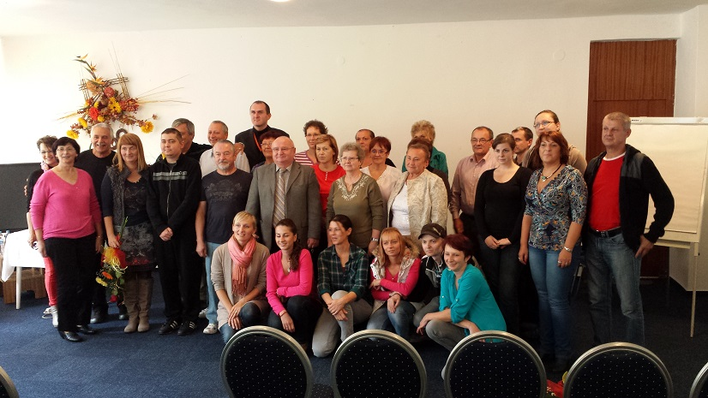
Slovak EBMT
Mediator in social counselling and assistance
Psychological assistance
Visits and meetings with cured patients or sharing and the staff education
Relaxation camps
Lectures
Physiotherapeutic treatment

Slide 25
Published on the website ebmt.sk
When it all began I thought...
I will never forget about the…
Thanks to the disease I have learnt that ...
So, if there were no trouble I…
My message for the new and forthcoming patients…

Slide 26
Thank you for your attention.

